Slide 1
Advance Decisions to Refuse Treatment: Your choices at the end of life
Professor Celia Kitzinger
kitzingercelia@gmail.com
Dying for Life
Cambridge, 11 May 2019

Slide 2
Co-founder of charity: ADA – Advance Decisions Assistance Website: www.ADassistance.org.uk
Adviser for Compassion in Dying – which has an excellent tool for making advance decisions
Website: mydecisions.org.uk

Slide 3
Family experience: Polly Kitzinger
Catastrophically brain injured in a car accident in 2009.
Family members all believed she have refused treatment if she could, given prognosis
Medical treatment delivered for years in vegetative + minimally conscious state
Survival with profound multiple physical + neurological disabilities + with quality of life she would not have considered worthwhile

Slide 4
What are Advance Decisions?
Mental Capacity Act 2005
Way of recording your decisions about future health care, for when you can no longer make or communicate such decisions
Used to be called ‘Living Wills’
Sometimes also called ‘Advance Directives’
(NOT the same as “Do Not Resuscitate”, TEP, ReSPECT, “Advance Care Plan” or “Power of Attorney”)

Slide 5
Advance Decision to protect against survival in PDOC or with profound neurological disability
I refuse all medical treatments (including but not limited to clinically assisted nutrition and hydration) aimed at prolonging or artificially sustaining my life if I am in a disorder of consciousness (e.g. coma, vegetative or minimally conscious state) for more than 6 weeks from date of injury. I maintain this refusal even if my life is shortened as a result.
Signed:………………………….
Witnessed: ………………………

Slide 6
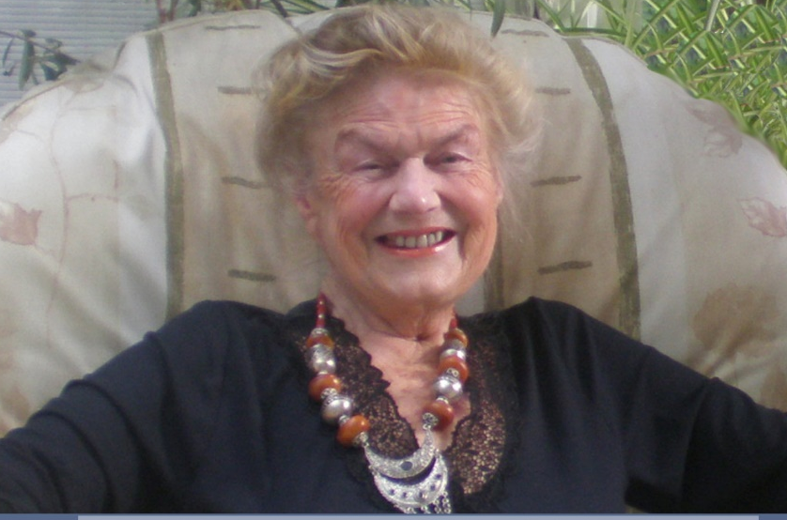
Sheila Kitzinger’s Advance Decision (Also Lasting Power of Attorney)
How to plan for a Good Death – article about
our mother’s death in The Guardian – click here
Sheila Kitzinger
Birth plans & planning for death
Home birth & home death
Warning: Do NOT use this as a model!
Died at home with cancer
11 April 2015

Slide 7
Common sentiments
If I’m ever like that, shoot me!
I don’t want to be kept alive tethered to machines if I’m just a vegetable
I hate the idea of a feeding tube/ventilator/blood transfusion …
If I have no quality of life, just let me go
I don’t want what happened to my father/wife/sister.....

Slide 8
If you have “mental capacity”…
You are the decision-maker.
You have the legal right to refuse treatment for any reason or for no reason at all
You have the legal right to make “unwise decisions”
You can refuse treatment that would have kept you alive (so that you die)
You have the legal right to kill yourself (although anyone who assists you commits a criminal offence)

Slide 9
Many of us will lose “mental capacity” towards the end of our lives
You don’t have mental capacity to make a decision if:
You have an impairment/disturbance of the mind or brain which....
... means that you can’t understand, retain and weigh information relevant to the decision (even after people have tried to help you)
Lack of capacity could be caused by:
progressive disease (e.g. dementia, Parkinson’s),
sudden brain injury (e.g. stroke, heart attack, falls, road traffic accident),
psychological factors (e.g. needle phobia),
medically induced (e.g. sedation to manage pain).
May be temporary or permanent

Slide 10
If you do NOT have mental capacity who makes decisions about your health care?
Doctor/ Clinical team
You have to do something if you want
to change this
Someone you choose – LPA (H&W)
https://www.gov.uk/power-of-attorney/overview
You (Advance Decision)
Combination of someone you choose - LPA (H&W) and You (AD)

Slide 11
Example of Advance Decision
“I refuse cardio-pulmonary resuscitation (CPR) under all circumstances. I maintain this refusal even if my life is shortened as a result.”
Signed _______________
Witnessed _____________
Date:_______________
This is a valid Advance Decision – legally binding on paramedics, hospital staff + general public

Slide 12
Why would anyone refuse CPR?
CPR = chest compressions, electric shocks to heart, tube in windpipe to help breathing, drugs to help heart start again.
When a person’s heart or breathing stops and the cause is reversible, immediate (CPR) offers a chance of life. However, when a person is dying—for example, from organ failure, frailty, or advanced cancer—and his or her heart stops as a final part of a dying process, CPR will not prevent death and may do harm.
CPR is often done when it won’t work. Only 2 out of 10 people who have CPR in hospital survive and go home from hospital – only 1 in 10 survive out-of-hospital CPR
CPR is forceful (‘brutal’) – broken ribs, tube down throat, ‘emergency’ not ‘peaceful’ death. Letter in British Medical Journal described it as “the routine, institutionalised electrocution and torture of the dying”
Even if CPR starts the heart again, more treatment is then needed often in intensive care unit (+ person may have brain damage and/or physical disabilities afterwards).

Slide 13
How would anyone know you’d refused CPR?
Give Advance Decision to GP
Ask GP to complete DNACPR form (which goes on ambulance service computer)
Use Lions Message in a Bottle scheme
Wear MedicAlert or S.O.S. Talisman jewellery
(see later)

Slide 14
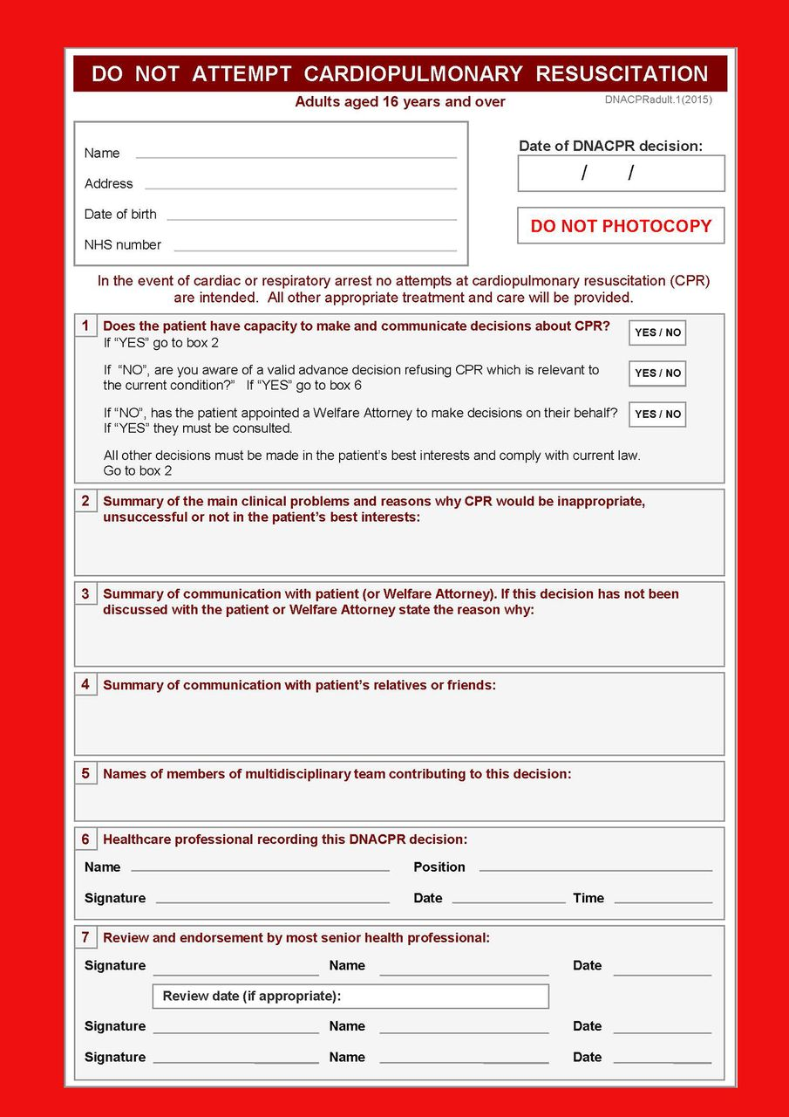
DNACPR form.
Zoë Fritz et al. BMJ 2017;356:bmj.j813
©2017 by British Medical Journal Publishing Group
Notes:
Fig 1 DNACPR decision form

Slide 15
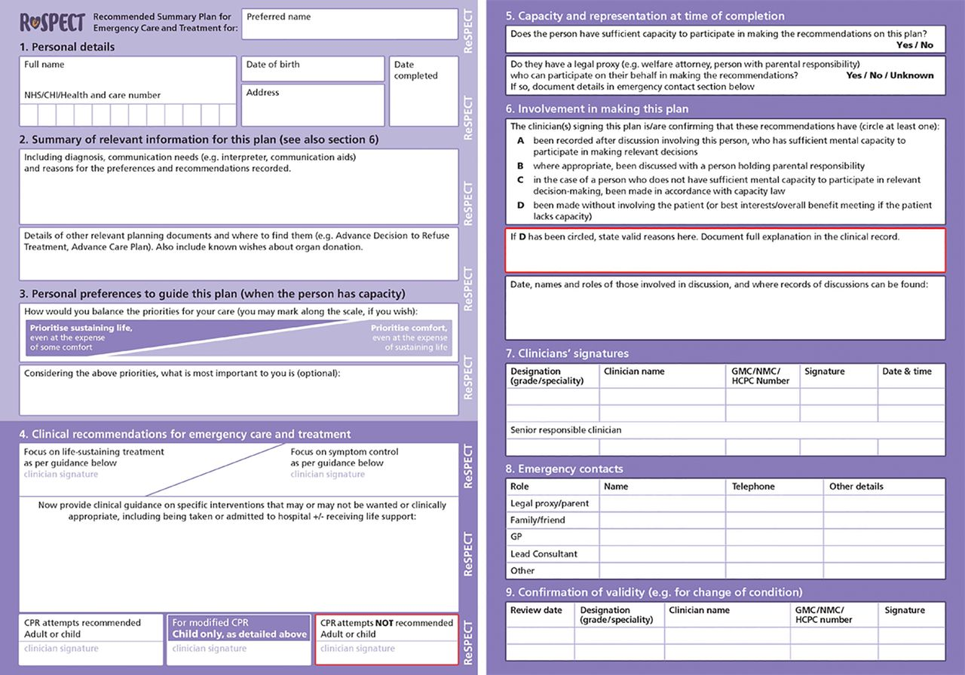
ReSPECT form.
Zoë Fritz et al. BMJ 2017;356:bmj.j813
©2017 by British Medical Journal Publishing Group
Notes:
Fig 2 ReSPECT form

Slide 16
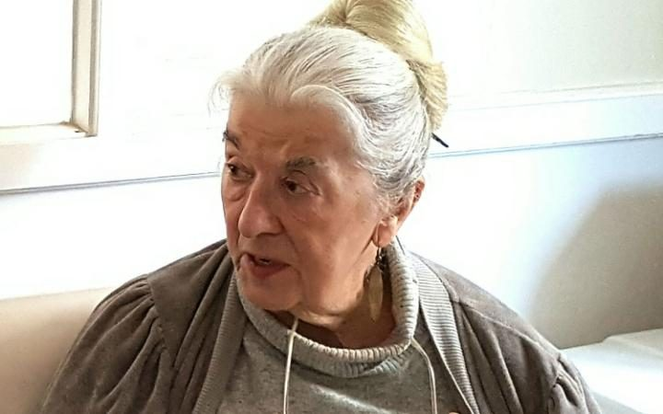
Advance Decisions refusing ALL life-prolonging treatments
“I refuse ALL medical treatment or procedures/interventions aimed at prolonging or artificially sustaining my life. I maintain this refusal of treatment in the hope that my life will be shortened as a result.”
(Extract from
Avril Henry’s
Advance Decision)

Slide 17
What treatments can be life-prolonging?
CPR
artificial ventilation
antibiotics for life-threatening infection
artificial nutrition + hydration (feeding tube)
physiotherapy
chemotherapy
dialysis
implantable cardioverter defibrillator (ICD)
insulin
your current medications?

Slide 18
Examples of ADs in practice
67 year old man with motor neurone disease
Tracheotomy – used communication board
Requested removal of ventilation 2 weeks after loss of ability to communicate
"In the event that my disease progresses to a stage where I am unable to communicate my needs and lose the ability to have any control over my decisions of my care and management. I fully understand the implication of the advance decision, and appreciate the consequences and it would put my life at risk. I consent to have relevant treatment before and after NIV removal to prevent me from becoming distressed or experiencing pain. However, apart from the above, I would not wish to have any life prolonging treatment, including my PEG feed".
(XB & YB [2012] EWHC 1390 (Fam))

Slide 19
WARNING
Many online forms for Advance Decisions are unhelpful and may not lead to valid and applicable treatment refusals in the way you intend.
They may not include the ‘magic sentence’.
They may not clearly indicate that you need a witness signature.
They may not support you to refuse the treatments you want in the circumstances you want.
The same is true of many ADs I’ve seen drawn up by solicitors. Beware!
Use Compassion in Dying as your first port of call! (And ADAssistance if you get stuck!)

Slide 20
Advance Statements

Slide 21
Refusing treatments if you are unlikely to recover ‘quality of life’
Advance Decision: I refuse all life-prolonging treatments if, in the opinion of two doctors, I am unlikely to recover to a quality of life that I would consider worthwhile. (See my Advance Statement where I say what I mean by that.)

Slide 22
Describe what you mean by ‘quality of life’ in Advance Statement
“Recovery to a quality of life that I regard as worth while”
“By ‘a quality of life that I would consider worth living’ I mean a return to normal independent living.”
“The quality of life I would want is being able to recognize my family and friends and to take pleasure from their company.”

Slide 23
Use the opportunity to express your values and beliefs – say what you value about life, what you fear, what matters to you as a person
Be persuasive to doctors (not just lawyers)
“I offer the healthcare team my heartfelt thanks for respecting my sincerely held wishes as expressed here”

Slide 24
Example of Advance Statement 1
“I don’t want to be left without what I call quality of life. I can’t imagine anything worse than not being able to do what I do now. I hate even being stuck indoors. I do the lunches, I do stroke club, I do befriending. I see a lot of people with disabilities and I could imagine living with a certain level of disability, but if I’d also lost capacity to make my own decisions, then I would be impaired in a way I wouldn’t want.”

Slide 25
Example of Advance Statement 2
“Independence, autonomy and intellectual competence and making my own choices are very important to me. I fear pain, confusion and powerlessness far more than I fear death. I do not wish those I love to become full-time carers if I cannot meet them with emotional and mental engagement and recognition. I would want them to go forward with their lives with joy.”

Slide 26
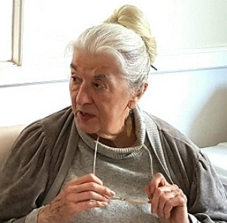
Example of Advance Statement 3
My long, happy, productive life is more than ‘complete’. Aged 80, I now live alone in incurable, unbearable pain (which cannot be relieved by opiates which render me dangerously dopey and incapable) and with crippling and progressive disabilities.
(continued on next slide)
Avril Henry

Slide 27
Lasting power of attorney

Slide 28
Common question(s):
How do I decide whether to make an Advance Decision or to appoint a Lasting Power of Attorney (for H&W)?
Do I need/should I have both?

Slide 29
Who can have an AD?
Anyone over 18 who wants to exercise their right to make their own decisions about medical treatments in advance of losing the capacity to do so (as long as they have mental capacity to make these decisions - can include people with depression/mental illness/early-stage dementia etc)

Slide 30
Some reasons for having an Advance Decision:
You want to retain decision-making power yourself
You don’t want to burden anyone else with decision-making responsibility
You may not have anyone you trust to make decisions for you

Slide 31
Reasons not to have an AD
Trust doctors to decide
Happy to have a friend/relative make all the decisions at the time – appoint them with Lasting Power of Attorney for Health and Welfare
Unsure what you want and don’t want – can’t think of ANYthing you’d be sure you’d want to refuse
Concern not to prejudge ‘future self’ – people find themselves valuing life in circumstances that they would previously have considered intolerable.

Slide 32
Some reasons for having an LPA:
You don’t want to have to try to predict an uncertain future – you prefer someone else to react to circumstances as they unfold
You want someone in particular to have decision-making responsibility (and perhaps not others …)
An LPA covers a MUCH wider range of situations than an AD
You may not have the capacity to write an AD (but do have the capacity to appoint an LPA)

Slide 33
Some reasons for having both:
‘Belt and braces’
Can make some decisions yourself, pass others to someone else
Your Attorney can make decisions in which your AD isn’t applicable
Note: In an AD, you can make decisions on any basis you want; an Attorney is constrained to act in your ‘best interests’

Slide 34
Things to consider if you have both an AD and an LPA
Danger that they might overlap: i.e. both cover the same area(s) of decision-making – esp. refusal of life-sustaining treatments
If they do overlap, and you haven’t specified otherwise, the one most recent takes precedence. (Note that an LPA doesn’t take effect until officially registered.)
Crucial to address relationship between AD and LPA

Slide 35
Specifying relationship between AD and LPA - use ‘instructions’ box on LPA form (here, person wants AD to have priority)

Slide 36
You don’t need a solicitor to make a Lasting Power of Attorney
Here’s the website (or google “Lasting Power of Attorney gov.uk”): https://www.gov.uk/power-of-attorney

Slide 37
Making an Advance decision effective

Slide 38
How do you make an AD?
Don’t need a solicitor
Can simply write out what you want to refuse sign it and get it witnessed
Or you can use ADA’s ‘case histories’ as a starting point for a ‘free-style’ AD (see http://adassistance.org.uk)
Or you can use a template: e.g. Compassion in Dying’s online tool ‘My Decisions’ (see https://mydecisions.org.uk)

Slide 39
Ensure that you are refusing what you want to refuse – many ADs do not in fact reflect person’s wishes (e.g. “permanent vegetative state” - means up to 1 year and excludes MCS)
If you change your mind UPDATE it!
Discuss with GP and/or medical specialists
If there is any possible doubt about your capacity at the point that you are making your AD (e.g. early dementia, mental illness, depression) get a ‘capacity’ statement
Review (possibly update) it every year – perhaps more often, especially if your circumstances change (Pre-2005 ‘living wills’ may well no longer be valid)
Write a strong, clear accompanying advance statement.

Slide 40
Brenda Grant wrote AD refusing life-prolonging treatments after caring for mother with dementia
George Eliot hospital, Nuneaton ‘misplaced’ it
After devastating stroke Brenda was fitted with PEG + maintained for 22 months
She hadn’t told her children about her AD
GP alerted children to it + supported them in getting it respected
Out of court settlement for £45,000

Slide 41
Make sure people know about your AD
No central register so…
Get it on your GP notes and lodged with specialists at hospital etc.
Give copies to family, friends, neighbours
Carry it with you; keep in your car
MedicAlert or S.O.S. Talisman jewellery; Lions ‘message in a bottle’ scheme
Revisit it before elective surgery – give it to hospital
If you are DNACPR ensure you are on the local Ambulance Service EOL register
Put in ‘Personal Care Plan’ folder (or equivalent)

Slide 42
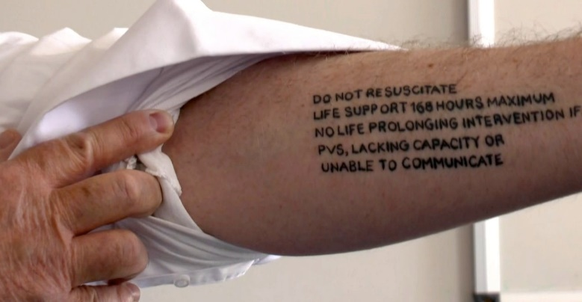
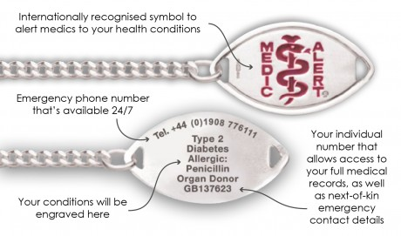
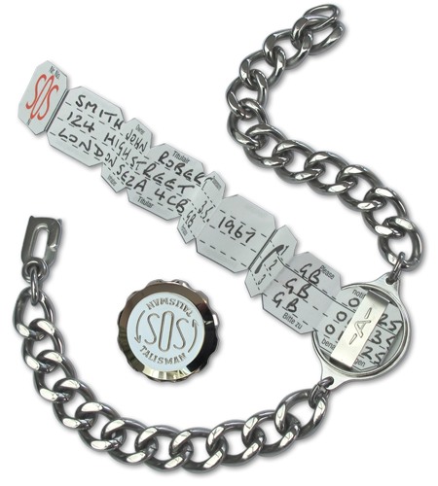
Tattoos don’t work: not legally binding

Slide 43
Making your own Advance Decision
Compassion in Dying has a great template
Compassionindying.org.uk
Or there are examples here:
ADassistance.org.uk
Both CiD and ADA have phone lines where you can get more information/support.

Slide 44
Online tool for making an AD: https://mydecisions.org.uk

Slide 45
Case histories: http://ADassistance.org.uk

Slide 46
Thank you!

